Slide 1

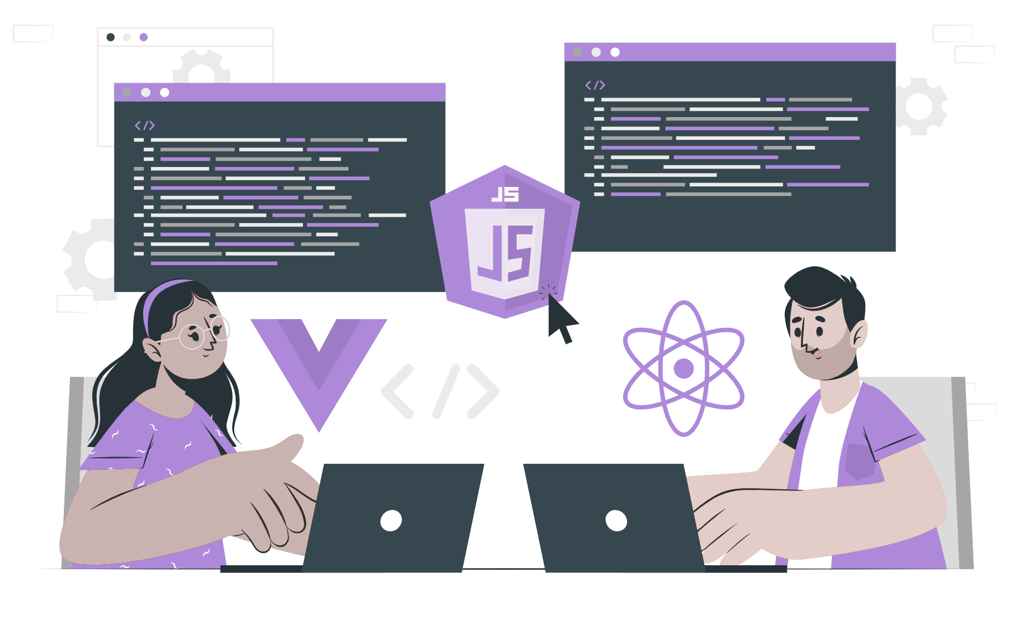
TCP/IP

Slide 2
Lecture CheckList
Introduction.
TCP/IP Model.
Layers of TCP/IP Protocol.
Working of TCP/IP Model.
Applications of TCP/IP.
Advantages of TCP/IP Model.
Disadvantages of TCP/IP Model.

Slide 3
Introduction
TCP/IP is a fundamental protocol suite used for communication over the internet and other computer networks. It stands for Transmission Control Protocol/Internet Protocol and consists of two main protocols: TCP and IP. TCP provides reliable, ordered, and error-checked delivery of data between applications, while IP is responsible for routing and addressing packets of data between computers. Understanding TCP/IP is essential for any network engineer, system administrator, or software developer, as it forms the backbone of modern networking and the internet. In this lecture, we will explore the basics of TCP/IP, its components, how it works, and its importance in modern-day networking. We will also discuss various applications of TCP/IP, such as web browsing, email, and file transfer, to name a few. By the end of this lecture, you will have a solid understanding of the TCP/IP protocol suite and its importance in today's interconnected world.

Slide 4
TCP/IP Model
The TCP/IP model is widely used for communication between devices on the Internet because it provides a standardized framework for communication. It was developed by the U.S. Department of Defense in the 1970s and has since become the standard for communication on the Internet.
The TCP/IP model is a networking model that is widely used for communication between devices on the Internet. It consists of four layers: the application layer, the transport layer, the internet layer, and the network access layer.
Notes:
When data is sent over a network using TCP/IP, it is first divided into packets, each of which is addressed and labeled with routing information. These packets are then transmitted across the network using the Internet Protocol (IP), which is responsible for ensuring that the packets are delivered to their intended destination.
At the receiving end, the packets are reassembled into the original data stream, and the Transmission Control Protocol (TCP) is used to ensure that all packets have been received and are in the correct order. TCP also provides error-checking and correction mechanisms to ensure that the data is accurate and complete.

Slide 5
Layers of TCP/IP Protocol
The TCP/IP model generally consists of four essential layers
Application Layer.
Host-To-Host Layer/Transport Layer.
Internet Layer/Network Layer.
Network Access Layer/Link Layer.

Slide 6
The Application Layer
This layer is where the user interacts with an application to send or receive data. Examples of applications are web browsers, email clients, and instant messaging programs.
The Application Layer in the TCP/IP model includes a variety of protocols that are used by applications to communicate with each other over the internet.
Notes:
Some of the most commonly used protocols in the Application Layer include:
HTTP (Hypertext Transfer Protocol): This protocol is used by web browsers and servers to exchange data over the internet. HTTP is used to request and retrieve web pages and other resources, such as images and videos.
SMTP (Simple Mail Transfer Protocol): This protocol is used to send email messages between servers. SMTP is responsible for sending messages from the sender's email client to the recipient's email server.
Telnet: This protocol is used to connect to a remote server or computer and control it from a local computer. Telnet is often used by system administrators to manage remote servers.

Slide 7
The Transport Layer
This layer is responsible for the reliable delivery of data from one application to another. It establishes a connection between the two devices. TCP ensures that all packets are delivered in the correct order and without errors.
It consists of two main protocols: Transmission Control Protocol (TCP) and User Datagram Protocol (UDP).
Notes:
It consists of two main protocols: Transmission Control Protocol (TCP) and User Datagram Protocol (UDP).
TCP (Transmission Control Protocol): TCP provides reliable, connection-oriented communication between applications. It establishes a virtual connection between two devices, ensuring that all data is transmitted in order and without errors. If any data is lost during transmission, TCP will automatically retransmit it to ensure that all data is received correctly. TCP is commonly used for applications that require high reliability, such as web browsing, file transfer, and email.
UDP (User Datagram Protocol): UDP provides a simpler, connectionless communication service between applications. It does not establish a virtual connection between devices and does not guarantee the reliable delivery of data. However, UDP is faster and more efficient than TCP, making it a good choice for applications that require speed over reliability, such as online gaming and streaming media.

Slide 8
The Internet Layer
This layer is responsible for routing data between networks. It uses the IP to send packets of data from one network to another. IP determines the best route for the packets to take and ensures that they arrive at the correct destination.
Notes:
Some of the commonly used protocols in the Internet Layer include:
IP (Internet Protocol): IP is the primary protocol used by the Internet Layer to route data between networks. It is responsible for determining the best route for packets of data to take and ensuring that they arrive at the correct destination. IP also performs fragmentation and reassembly of packets, allowing data to be transmitted efficiently over networks with different maximum packet sizes.
ICMP (Internet Control Message Protocol): ICMP is used by network devices to report errors and status information to other devices on the network. It is commonly used by diagnostic tools to test network connectivity and troubleshoot network issues.

Slide 9
The Link Layer
This layer is responsible for transmitting data over a physical network connection. It includes protocols such as Ethernet and Wi-Fi. The Link layer ensures that packets are transmitted correctly over the physical connection.
Notes:
Ethernet: Ethernet is the most common protocol used in the Link Layer. It defines the rules for transmitting data over a wired network and is used by devices such as computers, printers, and routers.
Wi-Fi: Wi-Fi is a wireless protocol used to connect devices to a network. It uses radio waves to transmit data and is commonly used in homes and businesses.
Since TCP/IP is an implementable model, some networking experts choose to separate the data link layer and physical layer from the Link Layer in the TCP/IP model, resulting in a five-layer model. This separation is sometimes done to achieve specific requirements for a particular network, such as increased efficiency or security.
Data Link Layer: This layer includes protocols that manage the physical connection between devices, such as Ethernet and Wi-Fi.
Physical Layer: This layer includes protocols that govern the physical transmission of data, such as copper and fiber-optic cabling.

Slide 10
Working of TCP/IP Model
The TCP/IP model provides a set of protocols that enable communication between devices on a network. When using the client-server model, the client device communicates with the server device using the TCP/IP protocol stack.
The client-server communication model is a fundamental concept of the TCP/IP model that describes how applications communicate with each other over the internet. In this model, there are two types of nodes: clients and servers.
Notes:
A server is a computer system that provides services to one or more clients. Examples of services provided by servers include web hosting, email hosting, file sharing, and database management. A client is a computer system that requests services from a server.
The communication between a client and a server is based on a request-response model. The client sends a request to the server, and the server responds with the requested information or service. This process is facilitated by several layers of the TCP/IP model.

Slide 11
Applications of TCP/IP
The TCP/IP protocol suite is the backbone of the modern internet and is used in a wide range of applications. Here are some of the key applications of TCP/IP:
Web Browsing.
Email.
File Transfer.
Video Streaming.
Voice over IP (VoIP).
Notes:
The TCP/IP protocol suite is the backbone of the modern internet and is used in a wide range of applications. Here are some of the key applications of TCP/IP:
Web Browsing: The TCP/IP protocol is used to enable web browsing, which is one of the most common activities on the internet. When you visit a website, your web browser uses the TCP/IP protocol to communicate with the web server and retrieve the content of the page.
Email: The Simple Mail Transfer Protocol (SMTP) is an Application Layer protocol in the TCP/IP stack that is used to send and receive email messages. SMTP is used by email clients such as Microsoft Outlook and webmail services like Gmail.
File Transfer: The TCP/IP protocol is used to enable file transfer between devices on a network. This includes both uploading and downloading files from a server, as well as transferring files between devices on a local network.
Video Streaming: The Transmission Control Protocol (TCP) is used to ensure the reliable transmission of data, which is important for video streaming applications. Video streaming services like Netflix and YouTube use the TCP/IP protocol to stream video content to viewers.
Voice over IP (VoIP): Voice over IP is a technology that enables voice communication over the internet. VoIP services like Skype and Zoom use the TCP/IP protocol to enable real-time communication between users.

Slide 12
Advantages of TCP/IP Model
Wide compatibility.
Scalability.
Open standards.
Reliable data transfer.
Flexibility.
Notes:
Wide compatibility: TCP/IP is the most widely used networking protocol in the world, and it is supported by almost all modern operating systems and network devices. This makes it easy to deploy and use on a wide range of devices and platforms.
Scalability: TCP/IP is designed to work on networks of all sizes, from small home networks to large enterprise networks. The protocol is designed to be scalable and can accommodate networks with a large number of devices and high levels of traffic.
Open standards: The TCP/IP protocol suite is based on open standards, which means that it is freely available and can be used by anyone. This makes it easy to develop new applications and services that can communicate over the network.
Reliable data transfer: The TCP protocol provides reliable data transfer, ensuring that data is delivered to the destination in the correct order and without errors. This is important for applications that require accurate and reliable data transfer, such as file transfers and video streaming.
Flexibility: The TCP/IP protocol suite is designed to be flexible and can be used for a wide range of applications. The protocol stack includes a number of different protocols that can be used depending on the specific requirements of the application.

Slide 13
Disadvantages of TCP/IP Model
While the TCP/IP protocol suite has many advantages, there are also some disadvantages to consider:
Security.
Complexity.
Notes:
While the TCP/IP protocol suite has many advantages, there are also some disadvantages to consider:
Security: The TCP/IP protocol suite was not designed with security in mind, and as a result, it is vulnerable to a variety of security threats. Network administrators must take extra steps to secure their networks and prevent these types of attacks.
Complexity: The TCP/IP protocol suite is a complex set of protocols that can be difficult to understand and configure. This complexity can make it challenging for network administrators to troubleshoot network issues and configure networks to meet specific requirements.

Slide 14
THANK YOU

